Slide 1
Proximal Policy Optimization Algorithms
Schulman et al., 2017
Presenter: Roberto Ruiz
09/29/2022

Slide 2
Motivation
Robots need suitable autonomous learning to achieve true autonomy
Trial-and-error improvement to acquire new skills
Learn in high-dimensional continuous state and actions spaces
Understanding of human motor control
Simulate human behavior
Learn cost functions based on simulated human behavior

Slide 3
Main Problem
Need reinforcement learning (RL) algorithms that
Scale to high-dimensional mechanical systems
Handle parametrized policies (e.g. neural network function approximators)
Data efficient
Robust
Ideally simple to implement

Slide 4
Preliminaries
Markov Decision Process (MDP)
(S, A, P, r, ⍴₀, Ɣ)
A finite set of actions
S finite set of states
P : S x A x S → ℝ
r : S → ℝ
⍴₀ : S → ℝ
Ɣ є (0, 1)
Actor-Critic Algorithms
Approximations to both policy and value functions
On-Policy vs Off-Policy
On-policy → evaluate or improve policy used to make decisions
Off-policy → evaluate or improve policy different from that used to make decisions

Slide 5
Policy Gradient Methods Background
Policy Gradient Methods for Reinforcement Learning with Function Approximation (Sutton et al., 2000)
Gradient suitable estimation from experience
Assisted by advantage function
Convergence of policy iteration with function approximation
Reinforcement learning of motor skills with policy gradients (Peters et al., 2008)
Survey policy gradient methods
Vanilla Policy Gradient Implementation
Algorithm
Documentation

Slide 6
Policy Gradient Methods
Compute estimator of policy gradient and plug into stochastic gradient ascent algorithm
Objective differentiated

Slide 7
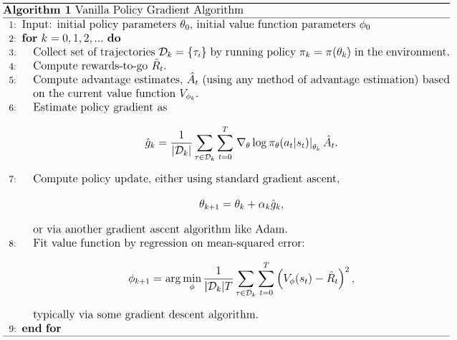
Policy Gradient Methods Limitations
Destructively large policy updates
Poor data efficiency and robustness

Slide 8
Trust Region Methods Background
Trust Region Policy Optimization (Schulman et al., 2017)
Initially proposed and proved monotonic improvement
KL divergence constraint
Robotic locomotion controllers learned from scratch
Trust Region Policy Optimization Implementation
Algorithm
Documentation

Slide 9
Trust Region Methods
Trust Region Policy Optimization (TRPO)
Surrogate objective maximized subject to constraint (δ) on policy update
Suggest using penalty instead of constraint

Slide 10
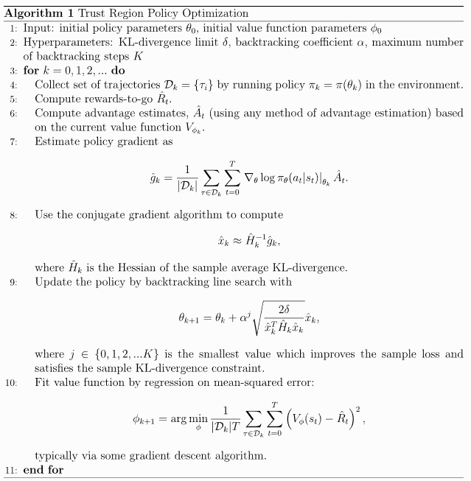
Trust Region Methods Limitations
Complex second-order method
Cannot choose fixed value of 𝛽 for KL penalty

Slide 11
Proximal Policy Optimization (PPO)
Policy update using multiple epochs of stochastic gradient ascent
Stability and reliability of trust-region methods
Simple implementation
Probability ratio
Conservative policy iteration (CPI) objective

Slide 12
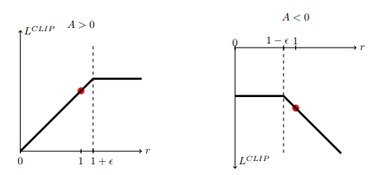
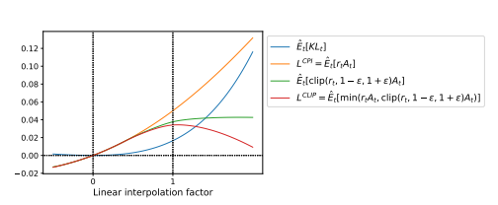
PPO CLIP
Penalize deviations that move r_{t}(𝜃) away from 1
Main surrogate objective function
If r_{t}(𝜃)
Improves objective → Exclude
Worsens objective → Include

Slide 13
PPO KL DIVERGENCE
Alternative to clipped surrogate objective
Use penalty on KL divergence
Adapt penalty → d_{targ}

Slide 14
PPO Algorithm

Slide 15
Experiment: Comparison of Surrogate Objectives
Surrogate objectives to be compared
Parametrized policy
Fully-connected MLP; two hidden layers (64 units); tanh nonlinearities; mean of Gaussian distribution output
Seven simulated robotics tasks
HalfCheetah, Hopper, InvertedDoublePendulum, InvertedPendulum, Reacher, Swimmer, Walker2d (-v1)
One million timesteps (training)
21 runs; average total reward of last 100 episodes; normalized (random policy → 0, best policy → 1)

Slide 16
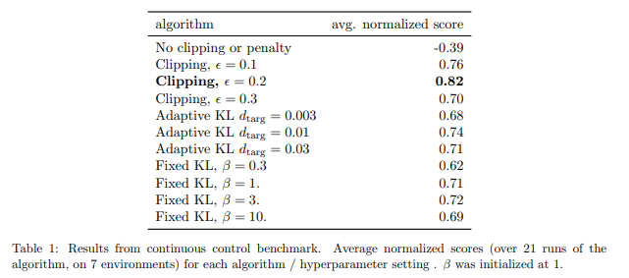
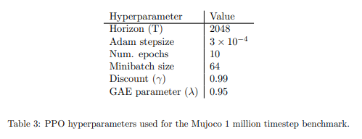
Results: Comparison of Surrogate Objectives

Slide 17
Experiment: PPO vs Continuous Domain Algorithms
Compare PPO (clipped surrogate objective) with
TRPO, CEM, vanilla policy gradient (adaptive stepsize), A2C, A2C (trust region)
Seven simulated robotics tasks (from previous experiment)
HalfCheetah, Hopper, InvertedDoublePendulum, InvertedPendulum, Reacher, Swimmer, Walker2d (-v1)
One million timesteps (training)

Slide 18
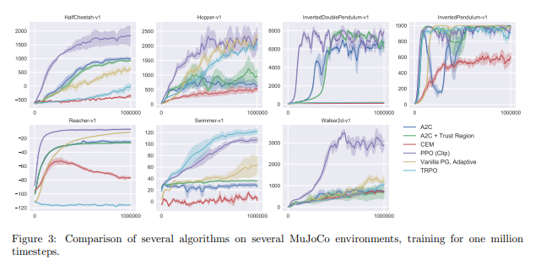
Results: PPO vs Continuous Domain Algorithms

Slide 19
Experiment: PPO Showcase Continuous Domain
3D humanoid tasks
RoboschoolHumanoid
RoboschoolHumanoidFlagrun
RoboschoolHumanoidFlagrunHarder
Learning curves of three tasks

Slide 20
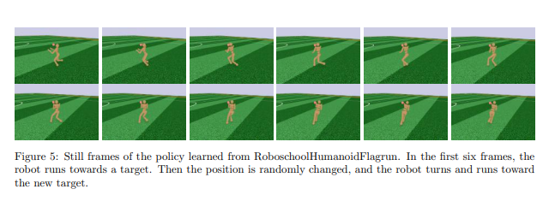
Results: PPO Showcase Continuous Domain

Slide 21
Experiment: PPO vs A2C vs ACER (Atari Domain)
Arcade Learning Environment (49 games)
Winner for each game defined by score metric
Scoring metrics:
Average reward per episode over entire training period
Average reward per episode over last 100 episodes of training

Slide 22
Results: PPO vs A2C vs ACER (Atari Domain)

Slide 23
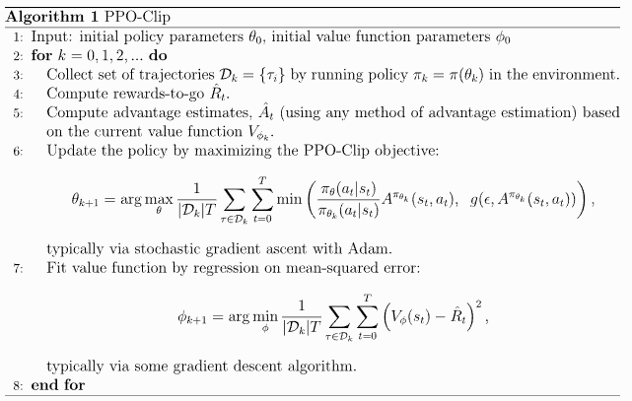
PPO Discussion of Results
Empirically better overall performance
Simpler first-order methods
Stability and reliability of trust-region methods

Slide 24
More on PPO
Limitations
Can get trapped in local optima
Still possible to end up with new policy too far from old policy
Extending PPO
Code-level optimizations for better performance
Tricks to avoid new policy being far off from old policy

Slide 25
Extended Readings
Reinforcement Learning An Introduction (Sutton et al., 2018)
Function Optimization Using Connectionist Reinforcement Learning Algorithms (Williams et al., 1991)
Policy Gradient Methods for Reinforcement Learning with Function Approximation (Sutton et al., 2000)
Reinforcement learning of motor skills with policy gradients (Peters et al., 2008)
Trust Region Policy Optimization (Schulman et al., 2017)
Implementation Matter in Deep Policy Gradients: A Case Study on PPO and TRPO (Engstrom et al., 2019)
Open AI Spinning Up Algorithm Documentation

Slide 26
Summary
Problem: Need RL algorithms that are scalable, handle parametrized policies, data efficient, robust, and ideally simple to implement
Importance: Robots with suitable autonomous learning
Limitations of prior work: Poor data efficiency and robustness; Destructively large policy updates; Complex second-order implementation
Key insight: Empirically better than TRPO; As stable and robust as TRPO; Simple first-order implementation

